Slide 1
Wide-Open Dorsal-Approach Septorhinoplasty and Its Effects on Preoperative and Postoperative Age Estimation in Patients
Betül Yılmaz¹
Orhan Özturan²

Slide 2
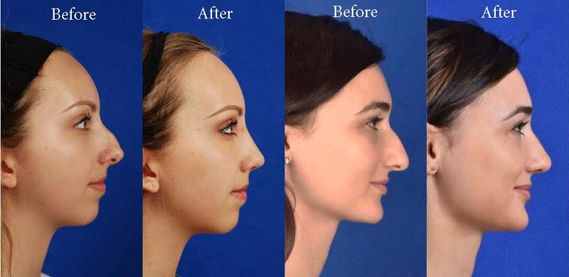
Introduction
Rhinoplasty ranks fifth among all plastic surgery procedures in the world.
The most common desire for rhinoplasty is to obtain a more aesthetic appearance.
After the operation, the person looks younger than before.

Slide 3
Aesthetic appearance
Traumatic deformities
Size of nostrils
Asymmetrical nose
Long/
arched nose

Slide 4
Introduction
Face-based age estimation can be defined as estimating the age of a person by evaluating facial biometric properties.
Today, machines began to play an important role, especially in surgical field.
Technologies for predicting age have also been involved in medicine, thereby helping to provide more visible information about the results of the operations by analyzing the facial features of the people.

Slide 5
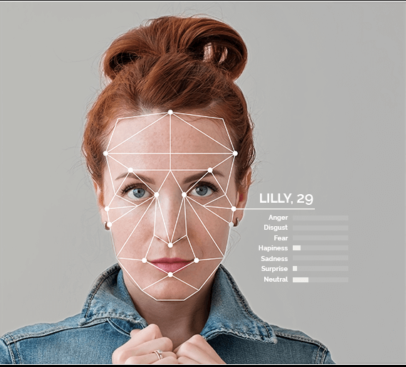

Slide 7
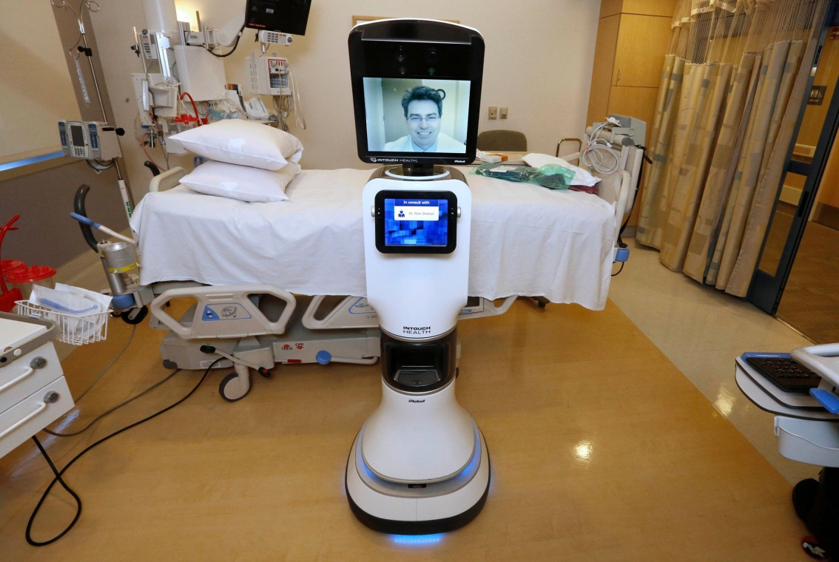
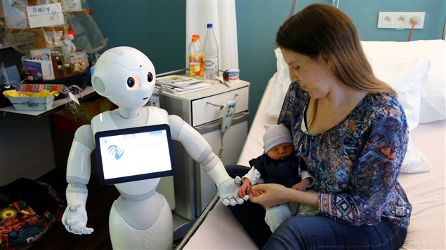

Slide 8
Introduction
As years go by, the deterioration in the bone structure causes changes in the face.
Nasal length and width significantly affects the visual age.
One of the most typical features of an old face is a droopy nose.
Droopy nose is shown more characteristically between the ages of 40-50.
Our patients had wide open dorsal approached rhinoplasty because of droopy noses.

Slide 9
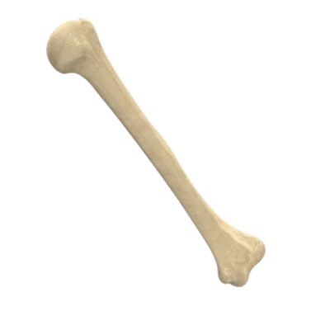
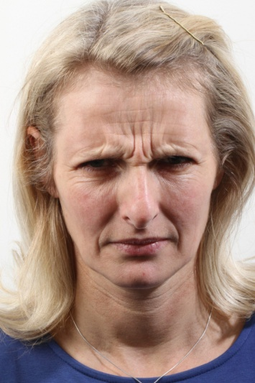
Extrinsic
Factors
Intrinsic
Factors

Slide 10
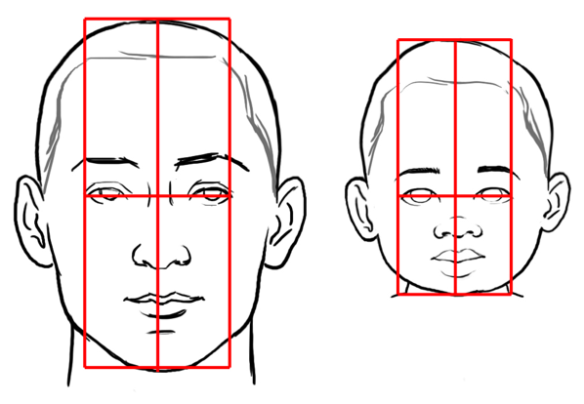

Slide 11
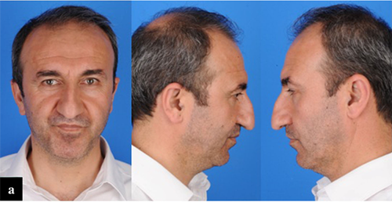

Slide 12
Age | Number of Participants
41 | 1
46 | 2
47 | 1
49 | 1
51 | 1
55 | 1
57 | 1
60 | 2
61 | 1
64 | 1

Slide 13
Hypothesis
In the age estimation the nose and the eyes are more informative than all the other components of the face (forehead, eyebrows, mouth and face shape).
Based on all information, it can be suggested that interventions performed in bone structure by rhinoplasty will also affect the visible age and therefore the age estimation.

Slide 14
Methodology
12 male patients
Ages between 41-64
Retrospective
Wide-open dorsal-approach septorhinoplasty surgery
Preoperative and postoperative photos
Visage Technologies face scanning software
Independent observers

Slide 15
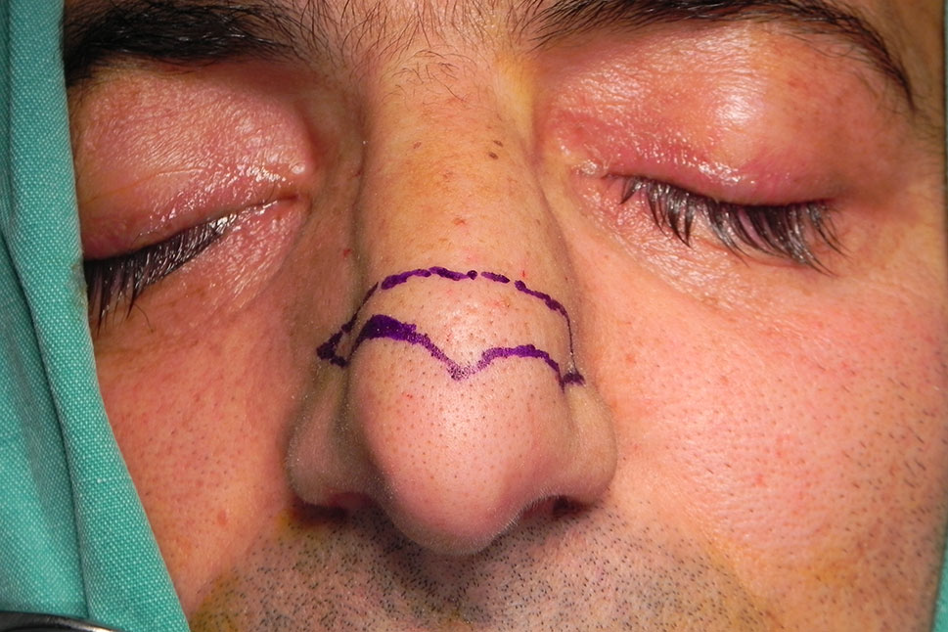

Slide 16
In transcolumellar incision, droopiness recurs after a few months.
In dorsal approach wide open septorhinoplasties, possibility of recurrence is reduced compared to other methods.
We are be able to compare only the preoperative and postoperative photographs of the patient without much exposure to other variables.

Slide 17
Iris perimeter
Location of the ears
Direction of gaze
Facial expression
Mood.
Gender
Age

Slide 18
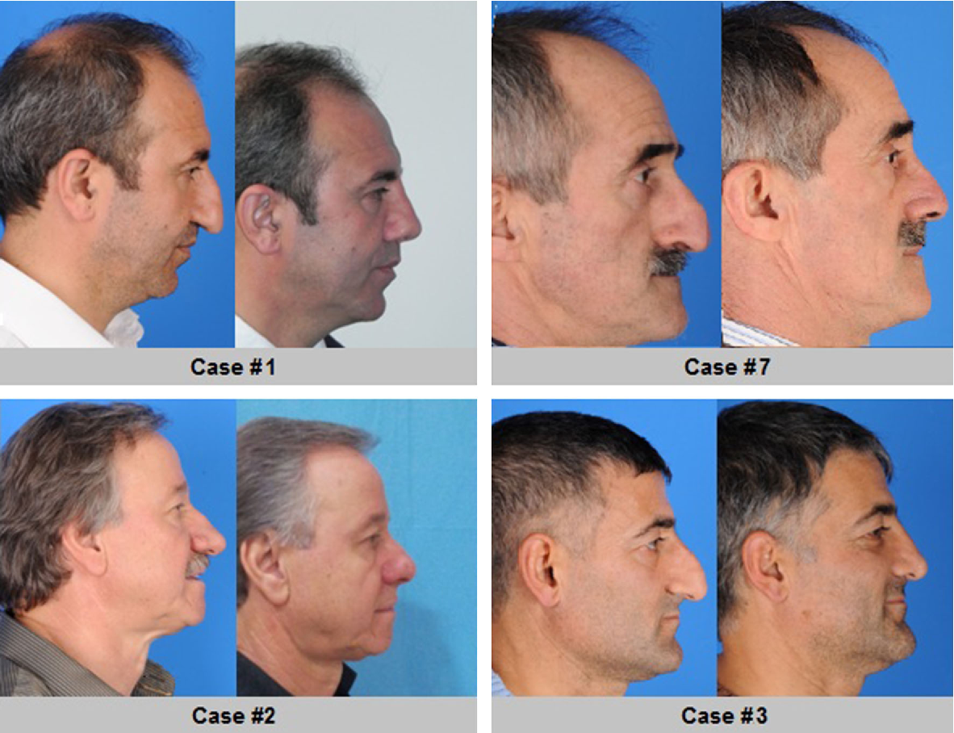

Slide 19
TABLE 1. Characteristics of the Subejcts and Values in the Age Recognition Software
Case | Preop Actual Age, y | Postop Actual Age, y | Preop Est Age, y | Postop Est Age, y
1 | 51 | 51 | 41 | 42
2 | 41 | 41 | 43 | 45
3 | 46 | 46 | 56 | 49
4 | 61 | 64 | 65 | 59
5 | 55 | 55 | 59 | 63
6 | 57 | 58 | 62 | 61
7 | 47 | 48 | 53 | 53
8 | 64 | 66 | 69 | 64
9 | 49 | 49 | 51 | 48
10 11 | 60 46 | 61 54 | 71 49 | 68 46
12 | 60 | 60 | 70 | 56
Postop indicates postoperative; preop, preoperative; est, estimated; y, years.

Slide 20
Findings
The mean ± SD real preoperative age of the subjects was 53.0 ± 4.1 years with a range from 41 to 64 years and the mean ± SD real postoperative age of the subjects was 54.4 ± 4.3 years with a range from 41 to 66 years.

Slide 21
Artificial Intelligence
The preoperative estimated age was 57.4 ± 5.8 years, which was significantly older than the actual age (p = 0.002).
The postoperative estimated age was 54.5 ± 4.8 years, which was slightly older than the actual age (p = 0.005).
The postoperative estimated age was not significantly younger than the preoperative estimated age (p = 0.055).

Slide 23
Artificial Intelligence
The preoperative estimated age significantly correlated with the actual age (r = 0.800, p = 0.002).
The postoperative estimated age significantly correlated with the actual age (r = 0.748, p = 0.005).

Slide 24
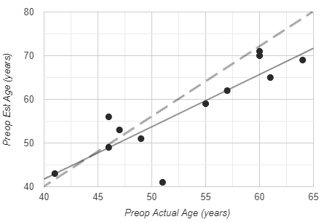
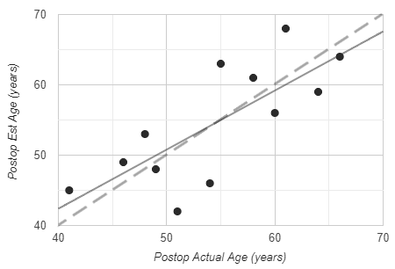

Slide 25
Artificial Intelligence
The difference between preoperative estimated age and the preoperative actual age for artificial intelligence was 4.33 ± 5.4 years, while the postoperative difference was 0.08 ± 5.7 years, but there was no significant correlation between (p = 0.031).

Slide 26
TABLE 2. Characteristics of the Subejcts and Values by Independent Observers
Case | Preop Actual Age, y | Postop Actual Age, y | Preop Est Age, y | Postop Est Age, y
1 | 51 | 51 | 45 | 49
2 | 41 | 41 | 37 | 34
3 | 46 | 46 | 47 | 47
4 | 61 | 64 | 60 | 62
5 | 55 | 55 | 61 | 60
6 | 57 | 58 | 55 | 56
7 | 47 | 48 | 44 | 46
8 | 64 | 66 | 63 | 60
9 | 49 | 49 | 41 | 40
10 11 | 60 46 | 61 54 | 69 47 | 66 46
12 | 60 | 60 | 58 | 59
Postop indicates postoperative; preop, preoperative; est, estimated; y, years.

Slide 27
Independent Observers
The preoperative estimated age was 52.2 ± 5.6 years, which was significantly younger than the actual age (p = 0.002).
The postoperative estimated age was 52.0 ± 5.5 years, which was significantly younger than the actual age (p < 0.001).
The postoperative estimated age was not significantly younger than the preoperative estimated age (p = 0.787).

Slide 29
Independent Observers
The preoperative estimated age significantly correlated with the actual age (r = 0.805, p = 0.002).
The postoperative estimated age significantly correlated with the actual age (r = 0.863, p < 0.001).

Slide 30
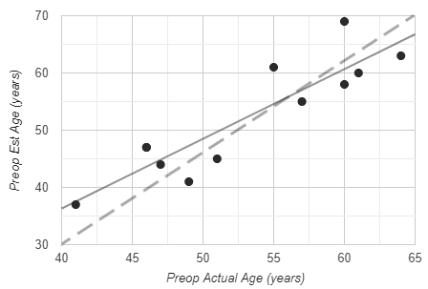
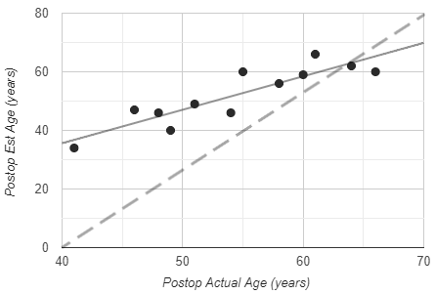

Slide 31
Independent Observers
The difference between preoperative estimated age and the preoperative actual age for human eye was -0.83 ± 4.5 years, while the postoperative difference was -2.33 ± 4.5 years, but there was no significant correlation between (p = 0.148).

Slide 32
Comparison Between A.I. & Human Eye
The preoperative estimated ages for artifical intelligence and human eye were significantly correlated (r = 0.844, p = 0.001) as well as the postoperative estimated ages (r = 0.814, p = 0.001).

Slide 33
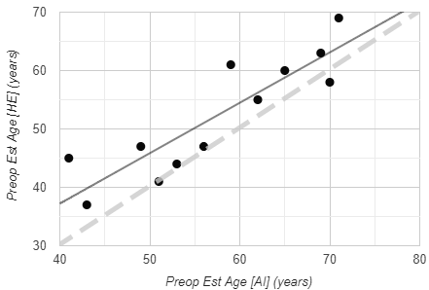
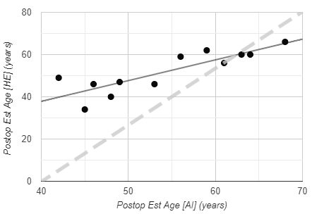

Slide 34
Conclusions
Our findings showed that both A.I. and human eye were successful in estimating the actual preoperative and postoperative ages of patients.
The A.I. is as accurate as human eye in estimating the preoperative and postoperative ages.
Postoperative estimated age was not significantly younger than the preoperative estimated age.

Slide 35
References
1. Chang I, Roostaeian J, Dorfman R, Saadat S. Making the Subjective Objective: Machine Learning and Rhinoplasty. Aesthet Surg J. 2020 Apr;40(5):493-498.
2.Sepehr A, Chauhan N, Alexander A, Adamson PA.The effect of rhinoplasty on perceived age.Arch Facial Plast Surg. 2012 Jan-Feb;14(1):68-70.
3. Stupak HD, Johnson Jr. JM.Rhinoplasty for the aging nose. Ear Nose Throat J. 2006 Mar;85(3):154-155.
4. Pontes JK, Britto Jr AS, Fookes C, Koerich AL. A flexible hierarchial approach for facial age estimation based on multiple features. Pattern Recognit. 2016 Jun;54:34-51.
5. Huerta I, Fernández C, Segura C, Hernando J, Prati A. A deep analysis on age estimation. Pattern Recognit Litt. 2015 Dec;68(2):239-249.

Slide 36
6. Han H, Otto C, Jain AK. (2013). Age Estimation from Face Images: Human vs. Machine Performance, presented at International Conference on Biometrics, Madrid, 2013.
7. Angeloni MA, Pereira RF, Pedrini H. (2019) Age Estimation from Facial Parts Using Compact Multi-Stream Convolutional Neural Networks, presented at IEEE International Conference on Computer Vision Workshops, Seoul, 2019.
8. Angulu R, Tapamo JR, Adewumi AO. Age estimations via face images: a survey. EURASIP J Image Video Process. 2018 Jun;42.
9. Kaur M, Garg RK, Singla S. Analysis of facial soft tissue changes with aging and their effects on facial morphology: A forensic perspective. Egypt J Forensic Sci. 2015 Jun;5(2):46-56
10. Albert AM, Ricanek Jr. K, Patterson E. A review of the literature on the aging adult skull and face: Implications for forensic science research and applications. Forensic Sci Int. 2007 Oct;172(1):1-9
11. Lin C, Li D, Lai J, Han M, Chang J. Automatic Age Estimation Systemfor Face Images. Int J Adv Robot Syst. 2012 Nov;9(5).
12. Farazdaghi E. Facial ageing and rejuvenation modeling including lifestyle behaviours, using biometrics-based approaches. Signal Image Process. Université Paris-Est, 2017.

Slide 37
13. Windhager S, Mitteroecker P, Rupić I, Lauc T, Polašek O, Schaefer K. Facial aging trajectories: A common shape pattern in male and female faces is disrupted after menopause. Am J Phys Anthropol. 2019 Aug;169(4):678-688.
14. Helleringer S, You C, Fleury L, Douillot L, Diouf I, Ndiaye CT, Delaunay V, Vidal R. Improving age measurement in low- and middle-income countries through computervision: A test in Senegal. Demogr Res. 2019 Jan-Jun;40(9):219-260.
15. Elwany S. TheAging Nose: Structure, Function, and Pathology. Int J Rhinol Otological. 2018 Apr;1(1): 001-003.
16. Ozturan O, Ozucer B, Aksoy F, Tugrul S. Wide-Open Dorsal Approach Rhinoplasty for Droopy Noses. Aesthetic Plast Surg. 2015 Feb;39(1):25-35.

Slide 38
Thank you for listening. ☺

